Slide 1
Adversarial Training
Savalam Bhavani

Slide 2
Agenda
Key Terminologies: Adversarial Example Perturbation Steps to Perform Perturbation
What is Adversarial Learning?
How Adversarial Learning Works?
Simple Code Implementation using Tensorflow
Advantages & Disadvantages of Adversarial Learning
Impact of Adversarial Attacks

Slide 3
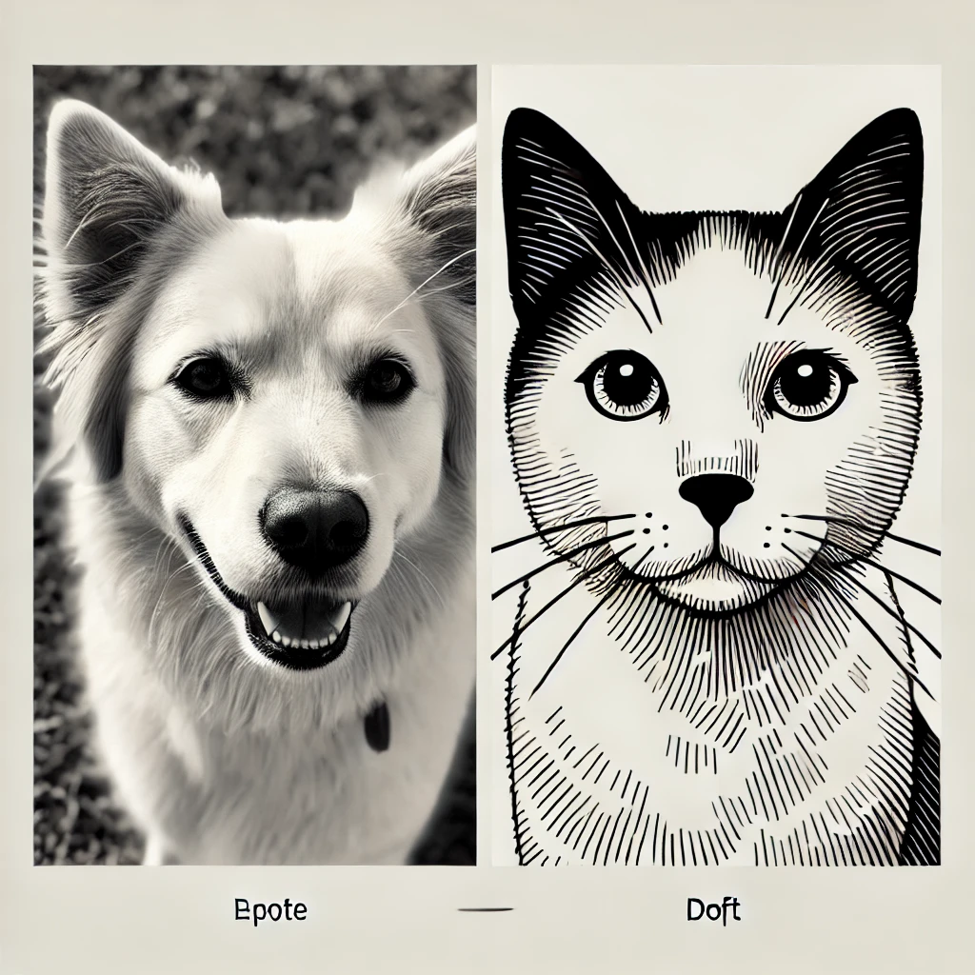
Adversarial examples
Example 1: Visible Domain Shift
A model trained on real-world images of cats and dogs may fail to correctly classify sketches or cartoons of them during testing. This happens because the training and testing data are visually different and come from distinct distributions.
Figure 1: Real world image (left) training & Sketches or cartoons(right) testing

Slide 4
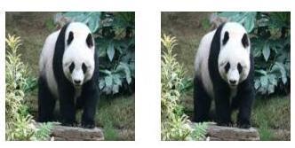
Adversarial examples
Example 2: Imperceptible Noise
A model may misclassify an image slightly altered with invisible noise. For example, an original panda image might be correctly classified as a panda, but when imperceptible noise is added, the same image could be misclassified as a badger, even though it looks identical to humans.
Figure 2: Original image of a panda (left) and corresponding adversarial example (right)

Slide 5
Key Terminologies
Perturbation: Slight modification to input data that may be imperceptible to humans but affects model predictions.
Steps to Perform Perturbation:
Calculate the Gradient of the Loss with Respect to the Input
Use the model’s loss function to determine how sensitive its predictions are to changes in the input.
2. Add Noise Based on the Gradient
The noise is scaled and added to the input to maximize the model's loss without visibly altering the input.
Example method:
Fast Gradient Sign Method (FGSM): Adds perturbations proportional to the sign of the gradient.

Slide 6
Adversarial examples
Such an example with imperceptible engineered noise added to it such that it changes the neural network’s prediction is commonly referred to as an Adversarial Example.
It is highly important to make our neural network-based systems robust to these adversarial examples so that the model does not drastically change its prediction when such engineered inputs that look the same as normal inputs to a human.
Adversarial example must have two properties:
It should look visibly the same as the original example
It should ‘fool’ our model and change its prediction.
Adversarial Attack: The process of generating adversarial examples (e.g., FGSM). (Sample of code)

Slide 7

Adversarial examples
Add a constant noise to an image and visualize when it starts looking different from the original input.
Figure 3 shows the image set with added noise. When the noise level is within ±10, we do not notice a significant difference between the original image (i.e., noise=0) case. When the noise is further increased, we noticed that the image gets brighter (as positive values are added) and darker (as negative noise values are added).

Slide 8
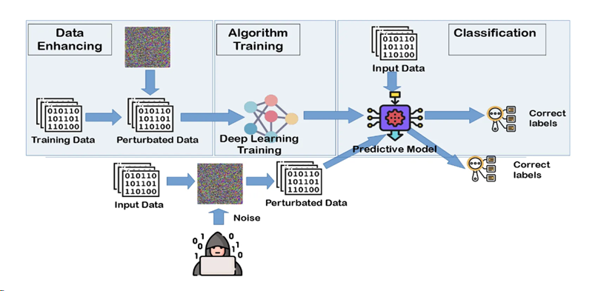
Adversarial Learning
Idea:
Adversarial learning is to train a model with adversarially perturbed data (called adversarial examples) in addition to the organic training data.

Slide 9
How Adversarial Learning Works?
Attacker:
Purpose: Generates adversarial examples by slightly modifying the original inputs to mislead the model.
Example: Changing pixel values of an image to make it look the same to humans but misclassified by the model.
Defender:
Purpose: Improves the model by training it to correctly classify adversarial examples.
Approach: Enhances the model’s ability to recognize both normal and adversarial patterns.
Objective:
Goal: Minimize the difference between adversarial and true predictions to improve robustness.
Result: A robust model that performs well even under adversarial attacks.

Slide 10
Simple Code Implementation
# Load a pre-trained model
model = tf.keras.applications.MobileNetV2(weights="imagenet")
# Define the loss function and calculate the gradient
loss_object = tf.keras.losses.CategoricalCrossentropy()
target_class_index = 386 # Example: Class index for 'African elephant'
with tf.GradientTape() as tape:
tape.watch(input_image)
predictions = model(input_image)
loss = loss_object(tf.one_hot([target_class_index], predictions.shape[-1]), predictions)
# Generate the perturbation
gradient = tape.gradient(loss, input_image)
perturbation = tf.sign(gradient)
Explanation:
Use a pre-trained model (e.g., MobileNetV2).
Generate adversarial noise using FGSM.
Visualize the difference between original and adversarial images.

Slide 11
Simple Code Implementation
# Add perturbation to the image
epsilon = 0.01 # Small scaling factor for imperceptibility
adversarial_image = input_image + epsilon * perturbation
adversarial_image = tf.clip_by_value(adversarial_image, -1, 1) # Ensure valid pixel range
# Visualize the original and adversarial images
plt.imshow((image_array / 255.0)) # Rescale for visualization
plt.axis("off")
Ideology:
Use a pre-trained model (e.g., MobileNetV2).
Generate adversarial noise using FGSM.
Visualize the difference between original and adversarial images.

Slide 12
Advantages of Adversarial Learning
Improved Model Robustness: Makes models resistant to small perturbations.
Better Generalization: Models handle unseen scenarios more effectively(Self driving cars).
Security Applications: Enhances the reliability of AI systems in critical fields like biometrics and autonomous vehicles.
Explains Model Behaviour: Highlights vulnerabilities in deep learning models.

Slide 13
Disadvantages of Adversarial Learning
High Computational Cost: Adversarial training requires more resources than standard training.
Incomplete Robustness: No defense is perfect against all types of adversarial attacks.
Reduced Model Accuracy: Models trained for robustness may show slightly lower performance on clean data.
Complexity: Implementing and understanding adversarial techniques can be challenging.

Slide 14
Resources:
https://www.tensorflow.org/neural_structured_learning/tutorials/adversarial_keras_cnn_mnist
https://www.tensorflow.org/tutorials/generative/adversarial_fgsm#implementing_fast_gradient_sign_method
https://youtu.be/Js2WJkhdU7k?si=bpYHFY2__eeFzu5R
https://pyimagesearch.com/2024/01/08/adversarial-learning-with-keras-and-tensorflow-part-1-overview-of-adversarial-learning/
https://en.wikipedia.org/wiki/Adversarial_machine_learning#Adversarial_deep_reinforcement_learning
https://www.aimasterclass.com/glossary/adversarial-training-for-robustness

Slide 15
Thank you ☺

